Slide 1
Image Enhancement in Frequency Domain

Slide 2
Introduction to Fourier Series and
Fourier Transform
Fourier Series:
“Any function that periodically repeats itself can be expressed as the sum of sine's and/or cosine’s of different frequencies, each multiplied by a different coefficient”.
Fourier Transform:
“Any function that are not periodic but whose area under the curve is finite, can be expressed as the integral of sine's and/or cosine’s multiplied by a weighing function”.
Note: A function expressed in either the Fourier series or transform, can be reconstructed completely via an inverse process, with no loss of information.

Slide 3
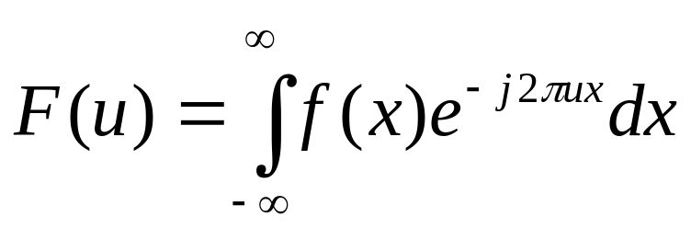
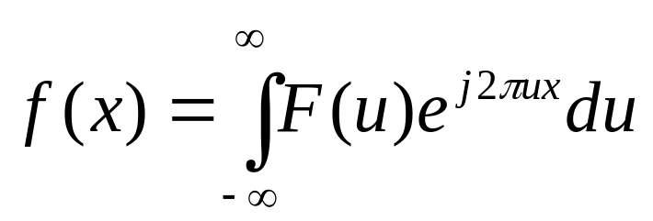
One-Dimensional Fourier Transform and its inverse
The Fourier Transform, F(u), of a single variable, continuous function, f(x) is defined by the equation
where j=√-1. conversely, given F(u), we can obtain f(x) by means of the inverse Fourier transform

Slide 4
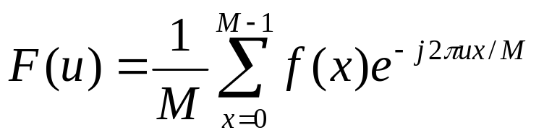
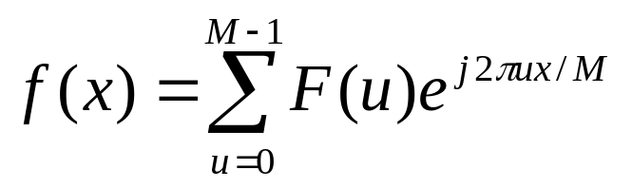
One- Dimensional Discrete Fourier Transform (DFT) and its inverse
The Discrete Fourier Transform, F(u), of a single variable, f(x), x=0,1,2,…,M-1, is given by the equation
for u=0, 1, 2, …, M-1
and the inverse DFT is given by
for x=0, 1, 2, …, M-1

Slide 5
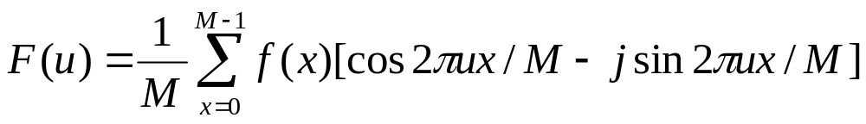
One- Dimensional Discrete Fourier Transform (DFT) and its inverse (contd..)
Euler’s Formula:
e^{jθ} = cos θ + j sin θ
substituting the expression in Equation of DFT gives
for u=0, 1, 2, …., M-1.

Slide 6
Frequency domain and Components
The domain (values of u) over which the values of F(u) range is called the frequency domain, because u determines the frequency components of the transform.
Each of the M terms of F(u) is called a frequency components of the transform.

Slide 7
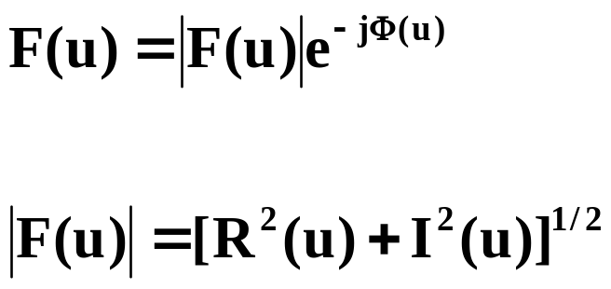
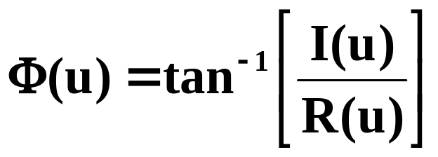
Fourier Transform in Polar Coordinates
F(u) in polar coordinates is given by
where
is called the magnitude or spectrum of the Fourier transform, and
is called the phase angle or phase spectrum of the transform, R(u) and I(u) are the real and imaginary parts of F(u)

Slide 8
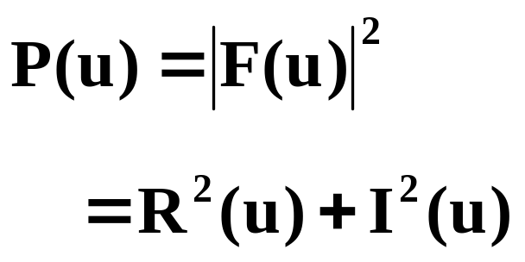
Fourier Transform in Polar Coordinates
Another important quantity frequently used is power spectrum or spectral density , defined as the square of the Fourier spectrum:

Slide 9
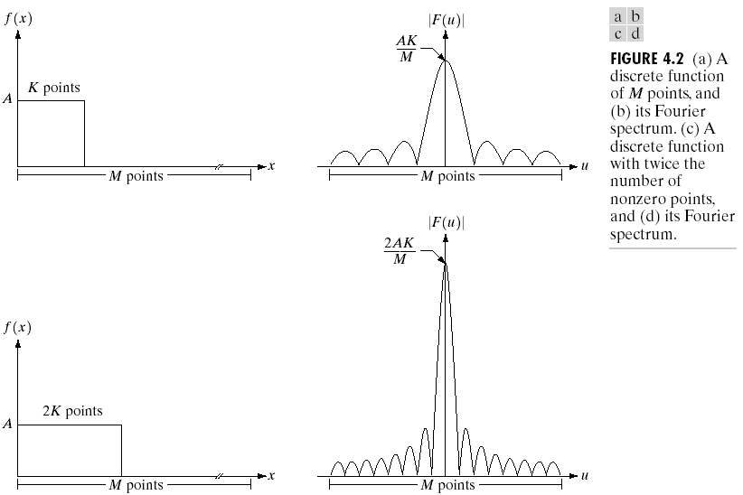
Example:
In this example M=1024, A=1, and K is 8 points

Slide 10
Note:
The spectrum is centered at u=0, this is accomplished by multiplying f(x) by (-1)^{x} before taking the transform.
The height of the spectrum doubled as the area under the curve in x-domain doubled.
The number of zeros in the spectrum in the same interval doubled as the length of the function doubled.

Slide 11
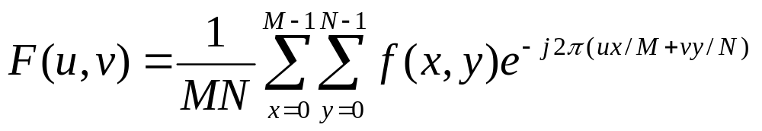
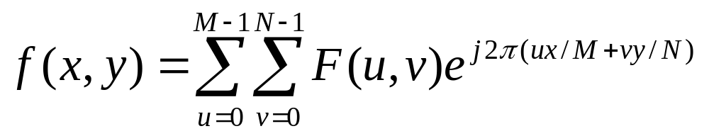
Two- Dimensional Discrete Fourier Transform (DFT) and its inverse
The Discrete Fourier Transform, F(u,v), of function, f(x,y), of size M x N is given by the equation
for u=0,1, 2, …,M-1 and v=0,1,2, ….,N-1 and the inverse DFT is given by
for x=0, 1, 2, …, M-1 and y= 0,1, 2, 3, …N-1

Slide 12
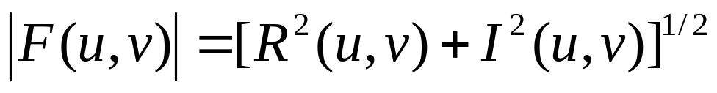
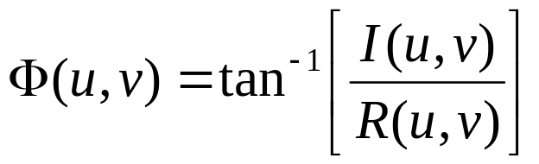
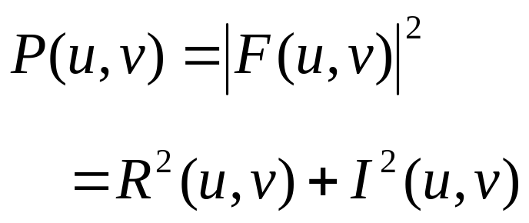
Fourier Transform in Polar Coordinates
We define the Fourier spectrum, phase angle, and power spectrum as

Slide 13
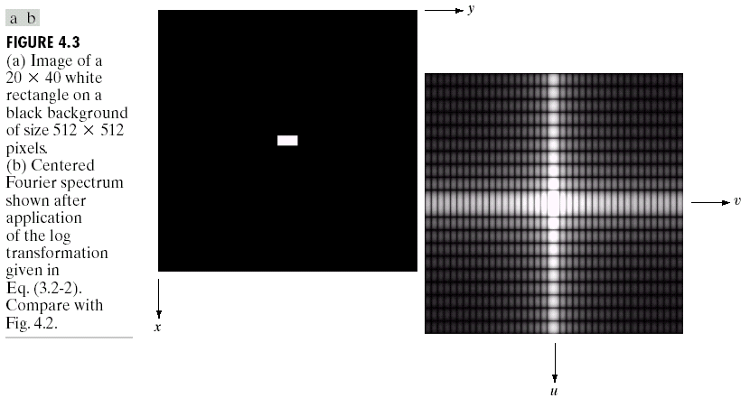
Example:

Slide 14
Filtering in Frequency domain
Properties of frequency domain:
The slowest varying frequency components (u=0 and v-0) corresponds to average gray level of an image.
As we move away from the origin, the low frequencies correspond to slowly varying components of an image.
As we move further away from the origin, the highest frequencies begin to correspond to faster and faster gray level changes in the image. These are the edges of the objects and other components of an image characterized by abrupt change in gray level, such as noise.

Slide 15
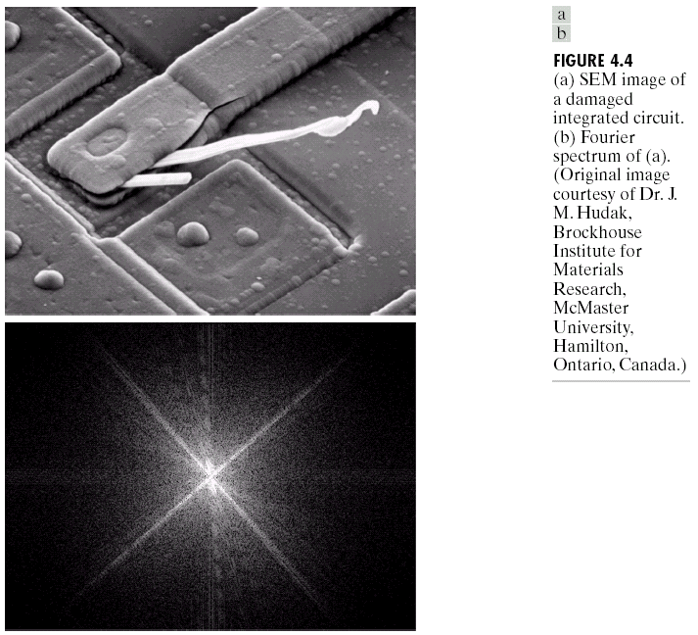

Slide 16
Basics of filtering in the frequency domain
It consists of the following steps:
  Multiply the input image by (-1)^{x+y} to center the transform.
  Compute F(u,v), the DFT of the image from 1
  Multiply F(u,v) by the filter function H(u,v)
  Compute the inverse DFT of the result in (3)
  Obtain the real part of the result in (4).
  Multiply the result in (5) by (-1)^{x+y.}

Slide 17
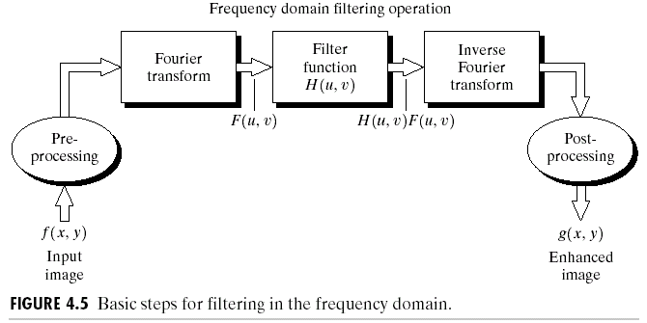

Slide 18
Basics of filtering in the frequency domain (contd..)
Let f (x, y) represent the input image in step 1and F (u, v) be its Fourier transform. Then the Fourier transform of the output image is given by
G (u, v)= H (u, v) F(u, v)
The multiplication of H and F involves two-dimensional functions and is defined on an element–by-element basis.
In general, the components of F are complex quantities, but the component of H are real. In this case each component of H multiplies both the real and imaginary part of corresponding components of F
Such filters are called zero-phase-shift filters. These filters do not change the phase of the transform.

Slide 19
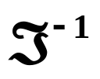
Basics of filtering in the frequency domain (contd..)
The filtered image is obtained by taking the inverse Fourier transform of G (u, v):
Filtered image = [G (u, v)]
The final image is obtained by taking real part of this result and multiplying it by (-1)^{x+y}

Slide 20
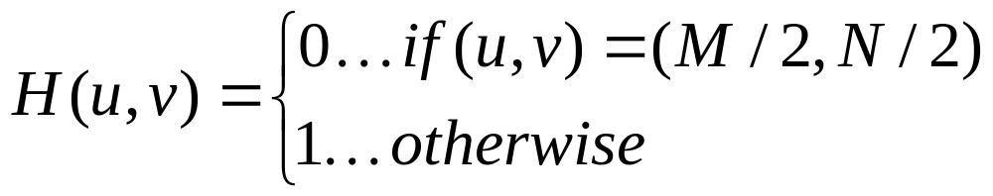
Some Basic filter and their properties
Notch Filter:
Suppose that we wish to force the average value of an image to zero.
According to the expression for Fourier transform, the average value of an image is given by F(0,0). The average value of the image will be zero if we set this term to zero
Assuming that transformation has been centered as discussed, we can perform this operation by multiplying all values of F (u, v) by the filter function:

Slide 21
Some Basic filter and their properties
Notch Filter (contd..):
This filter is called notch filter because it is a constant function with a hole at the origin.
This type of filters drops overall average gray level resulting from forcing the average value to zero.
Notch filter are useful tool when it is possible to identify spatial image effects caused by specific, localized frequency domain components.

Slide 22
Example: Original Image

Slide 23
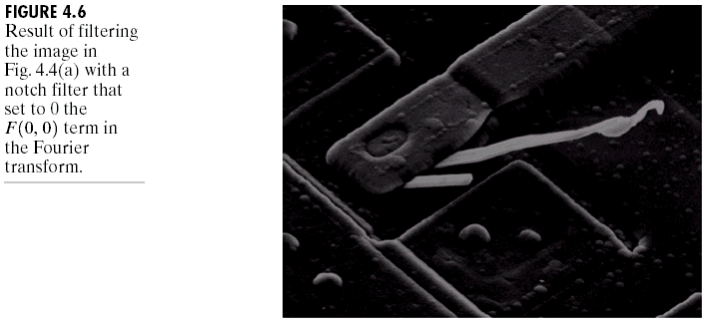
Example: Notch Filter

Slide 24
Some Basic filter and their properties
Low pass and High pass Filter:
Low frequencies in Fourier transform are responsible for general gray-level appearance of an image over smooth areas.
High frequencies are responsible for detail, such as edges and noise.
A filter that attenuates high frequencies while passing low frequencies is called a low pass filter and a filter that attenuates low frequencies while passing high frequencies are called a high pass filter
We expect a low pass filtered image to have less sharp detail than the original and high pass filtered image would have less gray level variation in smooth areas and emphasized transitional gray-level details (e.. Edges).

Slide 25
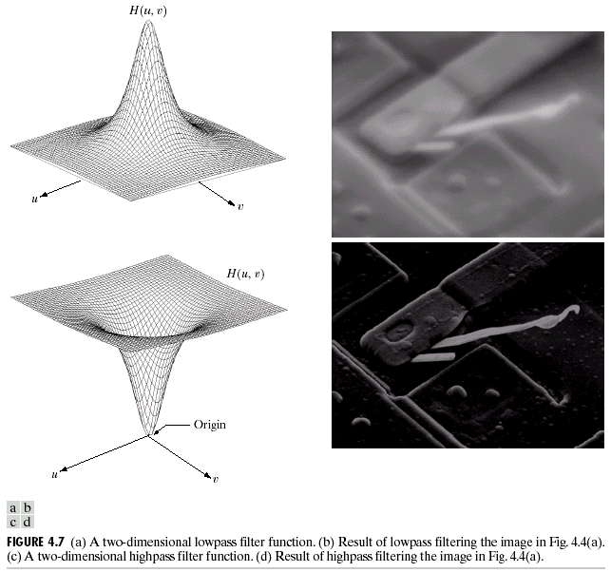
Example: Low pass and High Pass Filter

Slide 26
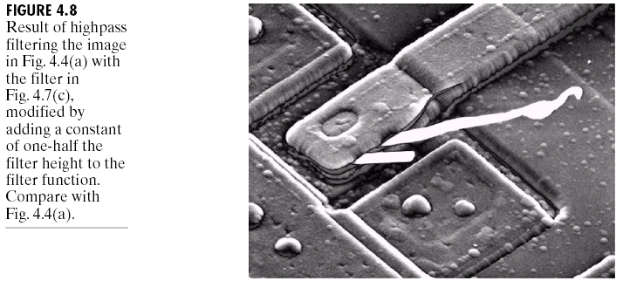
Example: High Pass Filter

Slide 27
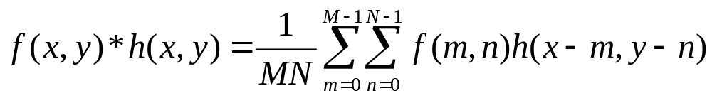
Correspondence between filtering in the Spatial and Frequency Domains
Convolution Theorem:
The discrete convolution of two functions f(x, y) and h(x,y) of size M x N is denoted by f(x,y) * h(x,y) and is defined by the expression
where h(x,y) is the inverse Fourier transform of the filter transfer function H(u,v).

Slide 28
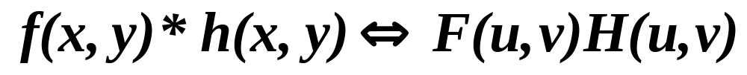
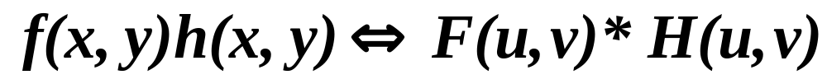
Convolution Theorem (contd..)
The Convolution theorem states that f(x,y)*h(x,y) and F(u,v)H(u,v) constitute a Fourier transform pair
An analogous result is that convolution in frequency domain reduces to multiplication in the spatial domain and vice versa; that is

Slide 29
Smoothing Frequency – Domain Filter
Smoothing (blurring) is achieved in the frequency domain by attenuating a specified range of high-frequency components in the transform of a given image.
Low pass filters is used for smoothing or blurring the image
We consider three types of low pass filters:
  Ideal Low Pass
  Butterworth Low Pass
  Gaussian Low pass
This filter cover the range from very sharp ideal to very smooth (gaussian) filter function.

Slide 30
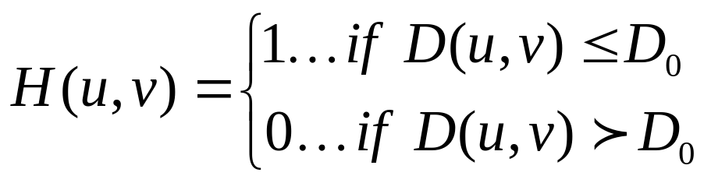
Smoothing Frequency – Domain Filter
Ideal Low pass Filters:
This filter “cuts off” all high frequency components of the Fourier transform that are at distance greater than specified distance D₀ from the origin of the centered transform.
Such filters is called a two-dimensional (2-D) ideal low pass filter (ILPF) and has the transfer function
Where D₀ is specified non negative quantity, D (u, v) is a distance from point (u, v) to the origin of the frequency rectangle.

Slide 31
Smoothing Frequency – Domain Filter
Ideal Low pass Filters (contd..):
The distance from any point (u, v) to the center (origin) of the Fourier transform is given by
For an ideal low pass filter cross section, the point of transition between H (u, v) =1 and H (u, v)=0 is called the cut-off frequency. In this case the cut-off frequency is D₀

Slide 32
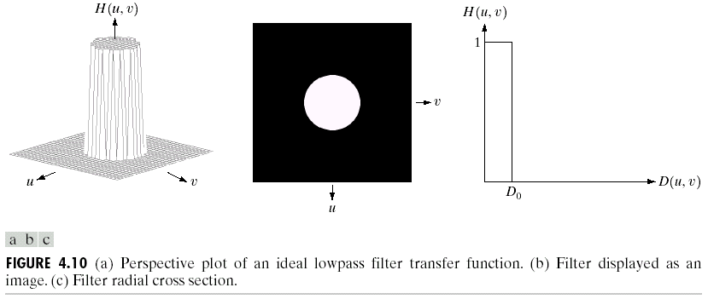
Example: Ideal Low pass Filter (ILPF)
All frequencies inside a circle of radius D₀ are passed with no attenuation, whereas all frequencies outside this circle are completely attenuated

Slide 33
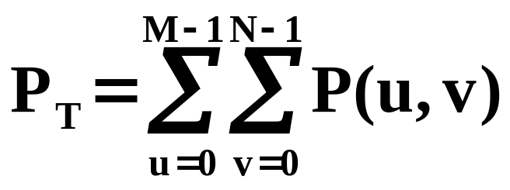
Smoothing Frequency – Domain Filter
Ideal Low pass Filters (contd..):
The ideal low pass filter are compared by studying their behavior as function of same cutoff frequencies.
One way to establish a set of cutoff frequency loci is to compute circles that enclose specified amounts of total image power P_{T.}
This quantity is obtained by summing the components of power spectrum P (u, v) at each point (u, v).

Slide 34
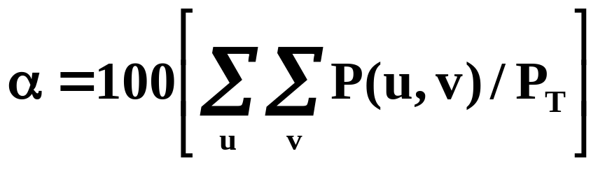
Smoothing Frequency – Domain Filter
Ideal Low pass Filters (contd..):
If the transform has been centered, a circle of radius r with origin at the center of the frequency rectangle encloses α percent of the power, where
The summation is taken over the values of (u, v) that lie inside the circle or its boundary.

Slide 35
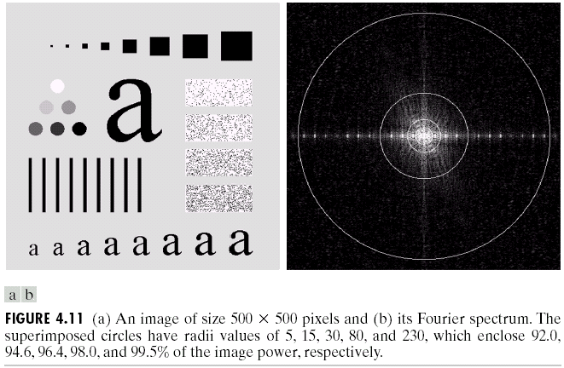
Example: Ideal Low pass Filter (ILPF)

Slide 36
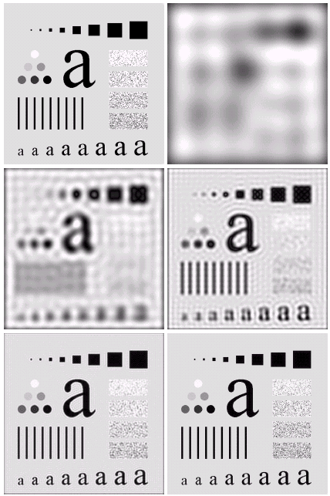

Example: Ideal Low pass Filter (ILPF)

Slide 37
Example: Ideal Low pass Filter (ILPF)
Figure 4.12 (b) is useless for all practical purpose, unless the objective of blurring in this case is to eliminate all the detail in the image, except the “blobs” representing the largest objects.
This severe blurring in this image indicates that most of the sharp detail information in the picture is contained in 8% power removed by the filter.
As the filter radius increases, less and less power is removed, resulting in less severe blurring.
Figure 4.12(c) through (e) are characterized by “ringing”, which becomes finer in texture as the amount of high frequency content removed decreases.

Slide 38
Properties of Ideal Low pass Filter (ILPF)
The blurring and ringing properties of the ILPF can be explained by reference to the convolution theorem.
The Fourier transform of th original image f(x,y) and the blurred image g(x,y) are related in the frequency domain by the equation
G(u,v)=H(u,v)F(u,v)
the convolution theorem tells us that
g(x,y)=h(x,y)*f(x,y)
where h(x,y) is the inverse Fourier transform of the filter transfer function H(u,v).

Slide 39
Properties of Ideal Low pass Filter (ILPF)
The spatial filter function h(x,y) was obtained as follwos:
  H(u,v) was multiplied by (-1)^{u+v} for centering
  This was followed by inverse DFT
  The real part of the inverse DFT was multiplied by (-1)^{x+y}
The filter h(x,y) has two distinctive characteristics: a dominant component at the origin, and concentric, circular components about the center components.
The center component is primarily responsible for blurring and the concentric components are responsible primarily for the ringing characteristics of the ideal filters.
Both the radius of the center component and the number of circles per unit distance from the origin are inversely proportional to the value of cut-off frequency.

Slide 40
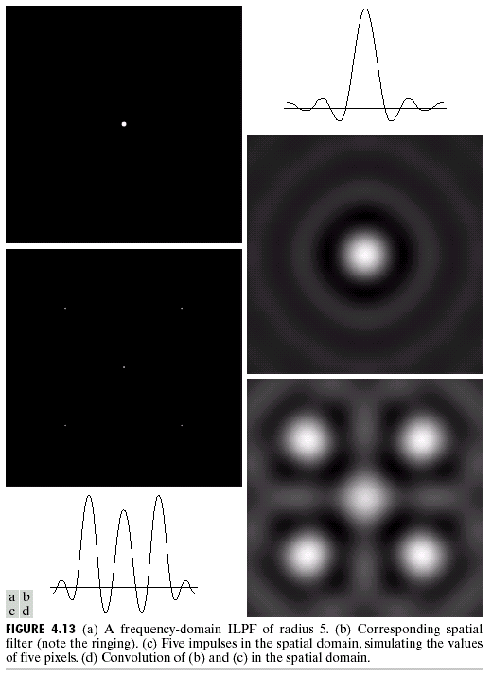
Properties of Ideal Low pass Filter (ILPF)

Slide 41
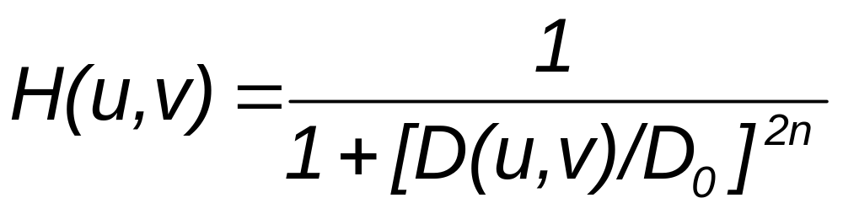
Butterworth Low pass Filters
The transfer function of a Butterworth low pass filter BLPF) of order n, and with cut-off frequency at a distance D₀ from the origin, is defined as
where D(u,v) is the Euclidean distance.

Slide 42
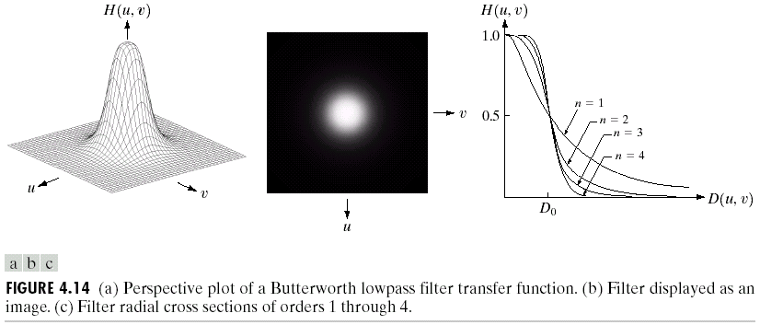
Butterworth Low pass Filters (contd..)
Unlike the ILPF, the BLPF transfer function does not have sharp discontinuity that establishes a clear cutoff between passed and filtered frequencies.

Slide 43
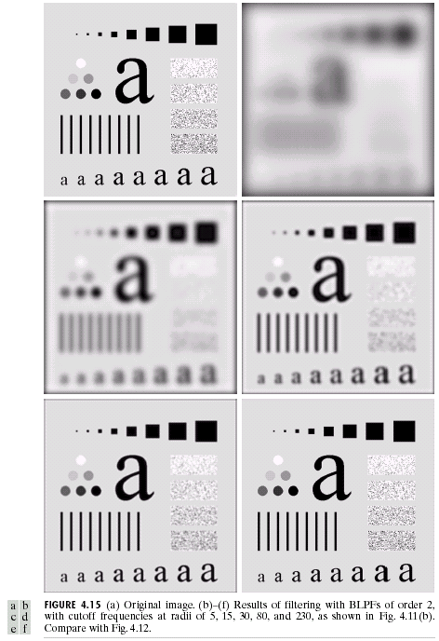
Example: Butterworth Low pass Filters

Slide 44
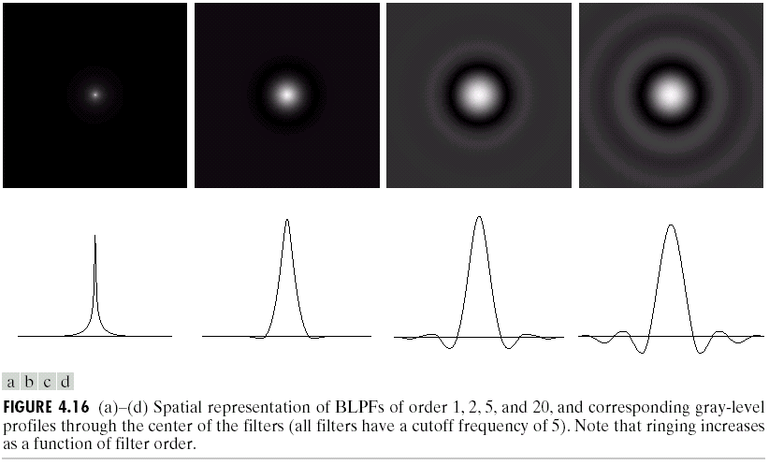
Properties of BLPF
A Butterworth filter of order 1 has no ringing. Ringing becomes a significant factor in filters of higher order.
Figure below shows an interesting comparison between the spatial representation of BLPF of various orders along with corresponding gray-level profile through the center of each filters

Slide 45
Properties of BLPF (contd..)
A Butterworth filter of order 1 has neither ringing nor negative values.
The filter of order 2 does show mild ringing and small negative values but less pronounced than in ILPF.
Remaining images shows that ringing in BLPF becomes significant for higher order filters
In general, BLPF’s of order 2 are good compromise between effective lowpass filtering and ringing characteristics.

Slide 46
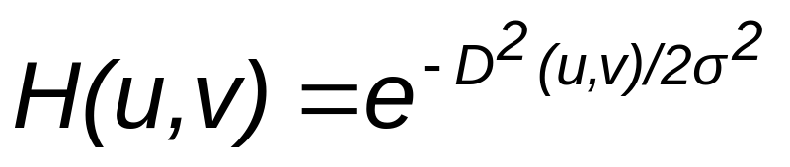
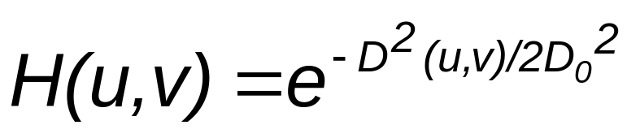
Gaussian Low pass Filters
The transfer function of a Gaussian low pass filter (GLPF) in two dimension is given by
where D(u,v) is distance from the origin of the Fourier transform and σ is a measure of the spread of Gaussian curve. If σ = D₀ (cutoff frequency) then
when D(u,v) = D₀, the filter is down to 0.607 of its maximum value.

Slide 47
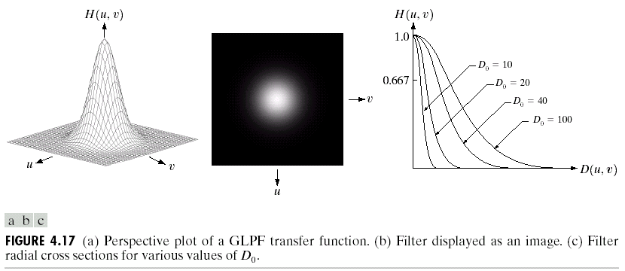
Gaussian Low pass Filters (contd..)

Slide 48
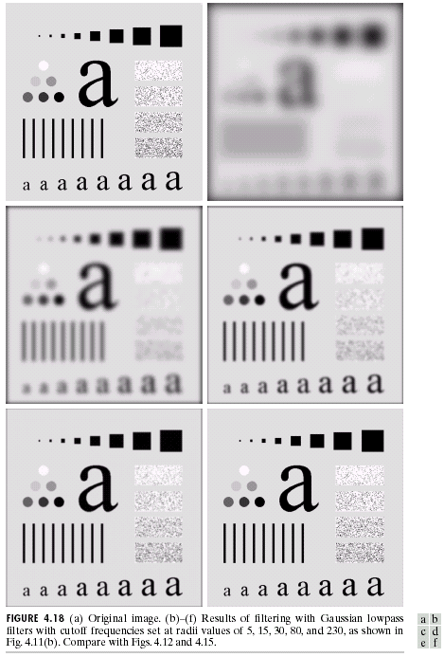
Example: Gaussian Low pass Filters

Slide 49
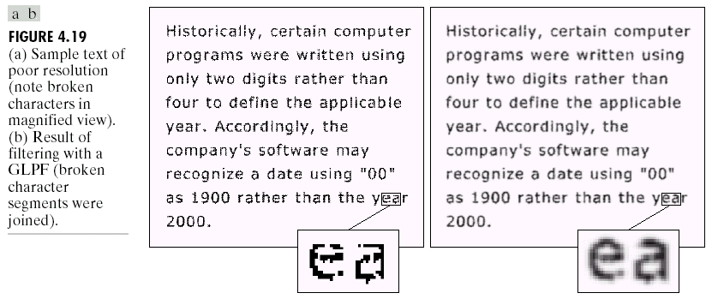
Example: Gaussian Low pass Filters

Slide 50
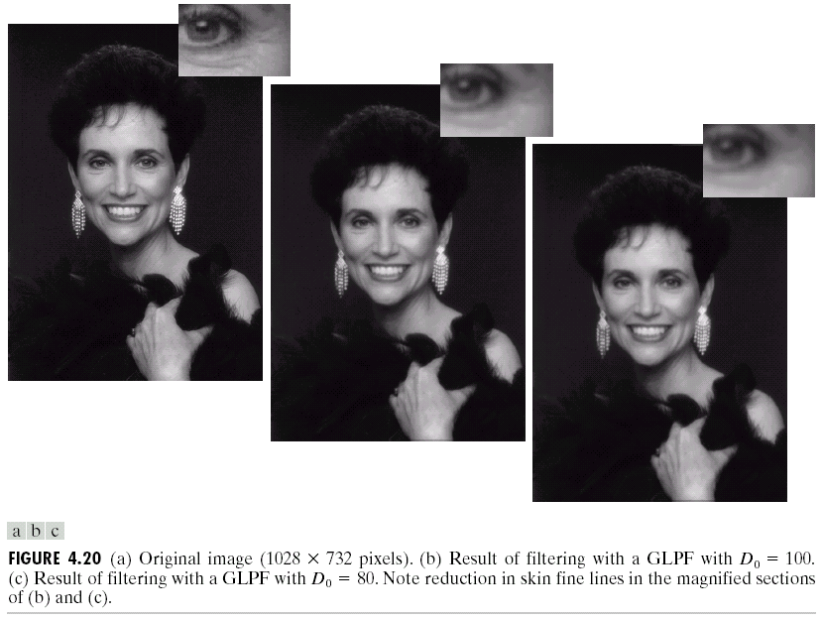
Example: Gaussian Low pass Filters

Slide 51
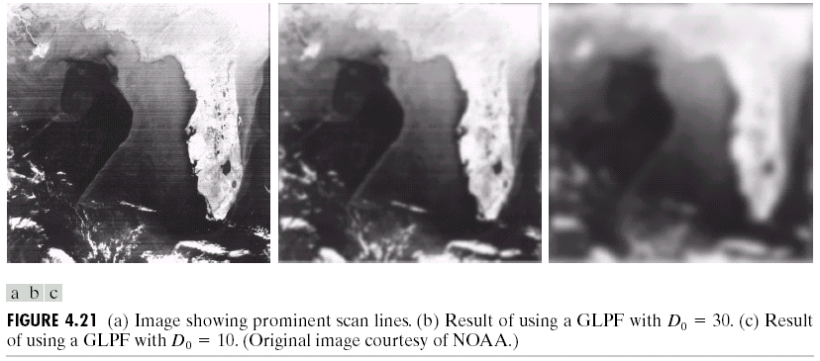
Example: Gaussian Low pass Filters

Slide 52
Sharpening Frequency – Domain Filter
Sharpening is achieved in the frequency domain by attenuating a specified range of low-frequency components without disturbing high-frequency information in the Fourier transform of a given image.
High pass filters is used for sharpening the image
Because the intended function of the filters is to perform precisely the reverse operation of low pass filters, high pass filters can be obtained using the relation
H_{hp}(u,v)=1-H_{lp}(u,v)

Slide 53
Sharpening Frequency – Domain Filter
We consider three types of High pass filters:
  Ideal High Pass
  Butterworth High Pass
  Gaussian High pass

Slide 54
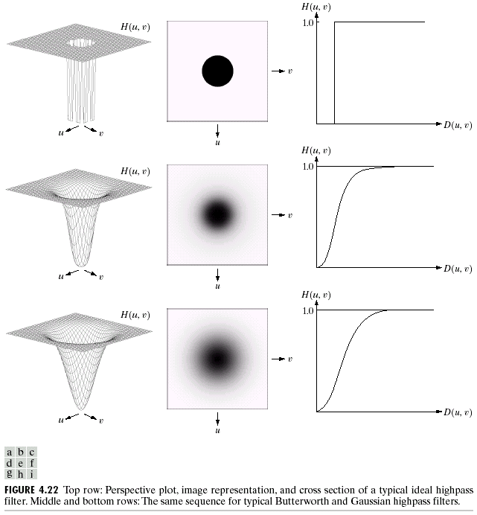
Perspective plot of high pass filters

Slide 55
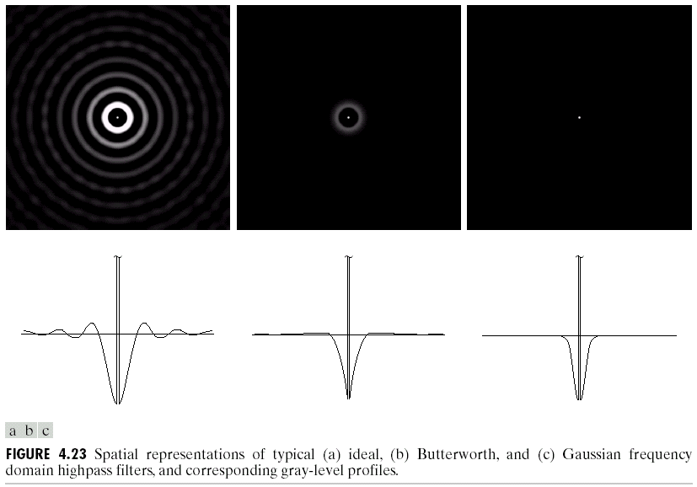
Spatial Representation of high pass filters

Slide 56
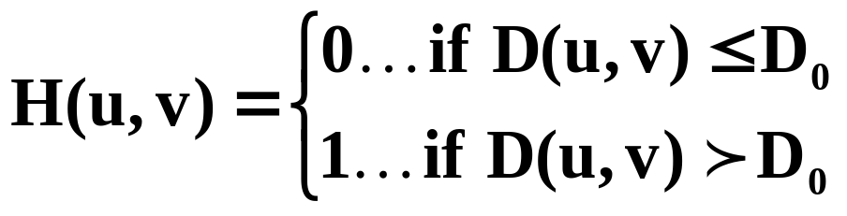
Sharpening Frequency – Domain Filter
Ideal High pass Filters:
A 2-D ideal high pass filter (IHPF) is defined as
Where D₀ is the cut-off distance measure from the origin of the frequency rectangle, and D(u,v) is the Euclidean distance

Slide 57
Example: Ideal High pass Filter (ILPF)

Slide 58
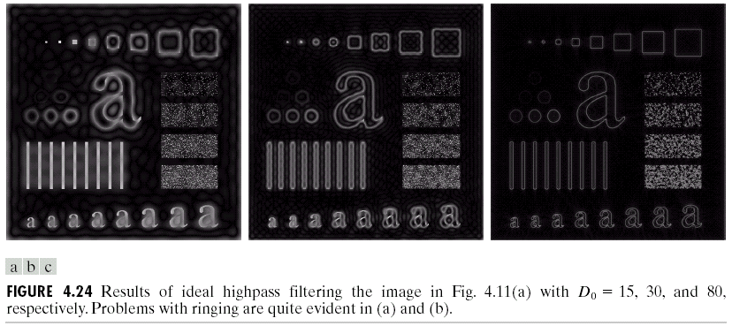
Example: Ideal High pass Filter (ILPF)

Slide 59
Example: Ideal High pass Filter (ILPF)
The ringing in Fig. 4.24(a) is so severe that it produced distorted, thickened object boundaries.
Edges of the top three circles are not shown because they are not as strong as the other edges in the images
For three top rows and the thin, vertical bars, the situation improves for higher value of D₀
The edges are much cleaner and less distorted for D_{o} = 80.

Slide 60
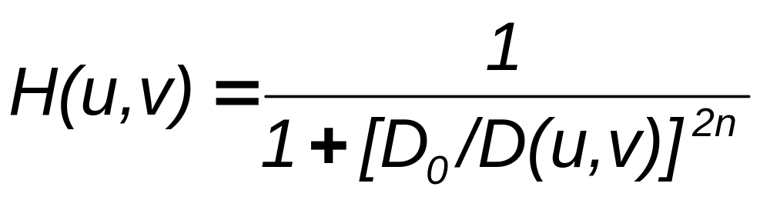
Butterworth High pass Filters
The transfer function of a Butterworth High pass filter BLPF) of order n, and with cut-off frequency at a distance D₀ from the origin, is defined as
where D(u,v) is the Euclidean distance.
BHPF behave smoother than IHPFs.

Slide 61
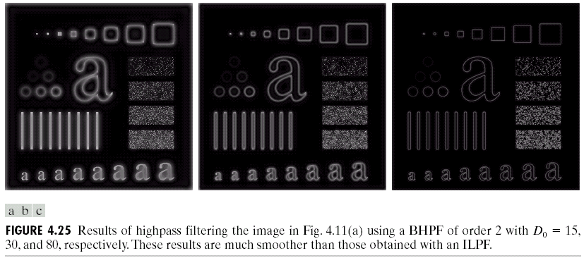
Example: Butterworth High pass Filters

Slide 62
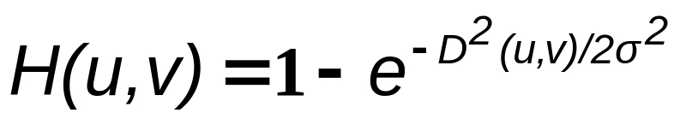

Gaussian High pass Filters
The transfer function of a Gaussian High pass filter (GLPF) in two dimension is given by
where D(u,v) is distance from the origin of the Fourier transform and σ is a measure of the spread of Gaussian curve. If σ = D₀ (cutoff frequency) then

Slide 63

Example: Gaussian High pass Filters

Slide 64


The Laplacian in the Frequency Domain
We know that
From this simple expression, it follows that

Slide 65
The Laplacian in the Frequency Domain (contd..)
Laplacian can be implemented in the frequency domain by using filter
H(u,v) = - (u² ⁺ v²)
As in all filtering operations, the assumption is that origin of F(u,v) has been centered by operation f(x,y)(-1)^{x+y}
This operation shifts center transform so that (u,v)=(0,0) is at point (M/2, N/2)
H(u,v) = - [(u - M/2)² ⁺ ⁽v - N/2)²]

Slide 66

The Laplacian in the Frequency Domain (contd..)
The Laplacian–filtered image in spatial domain is obtained by computing the inverse Fourier transform of H(u,v)F(u,v):
Enhanced image g(x,y) is formed by subtracting the Laplacian from the original image:

Slide 67
The Laplacian in the Frequency Domain (contd..)
The Laplacian–filtered image in frequency domain is obtained with a single inverse transform operation:

Slide 68

Example: Laplacian in frequency domain

Slide 69

Example: Laplacian in frequency domain

